Slide 1
Passing Parameters to and from Procedures
4 major ways:
Passing parameters in registers
Passing parameters in general memory
Passing parameters using pointers
Passing parameters using the stack

Slide 2
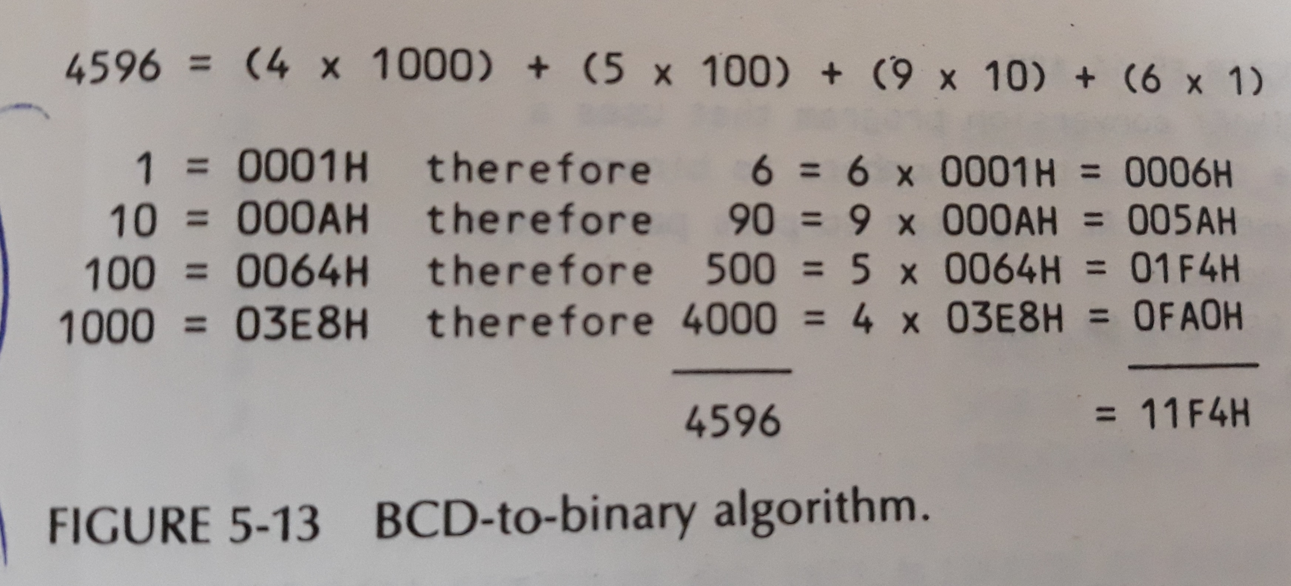
Packed BCD to Binary

Slide 3
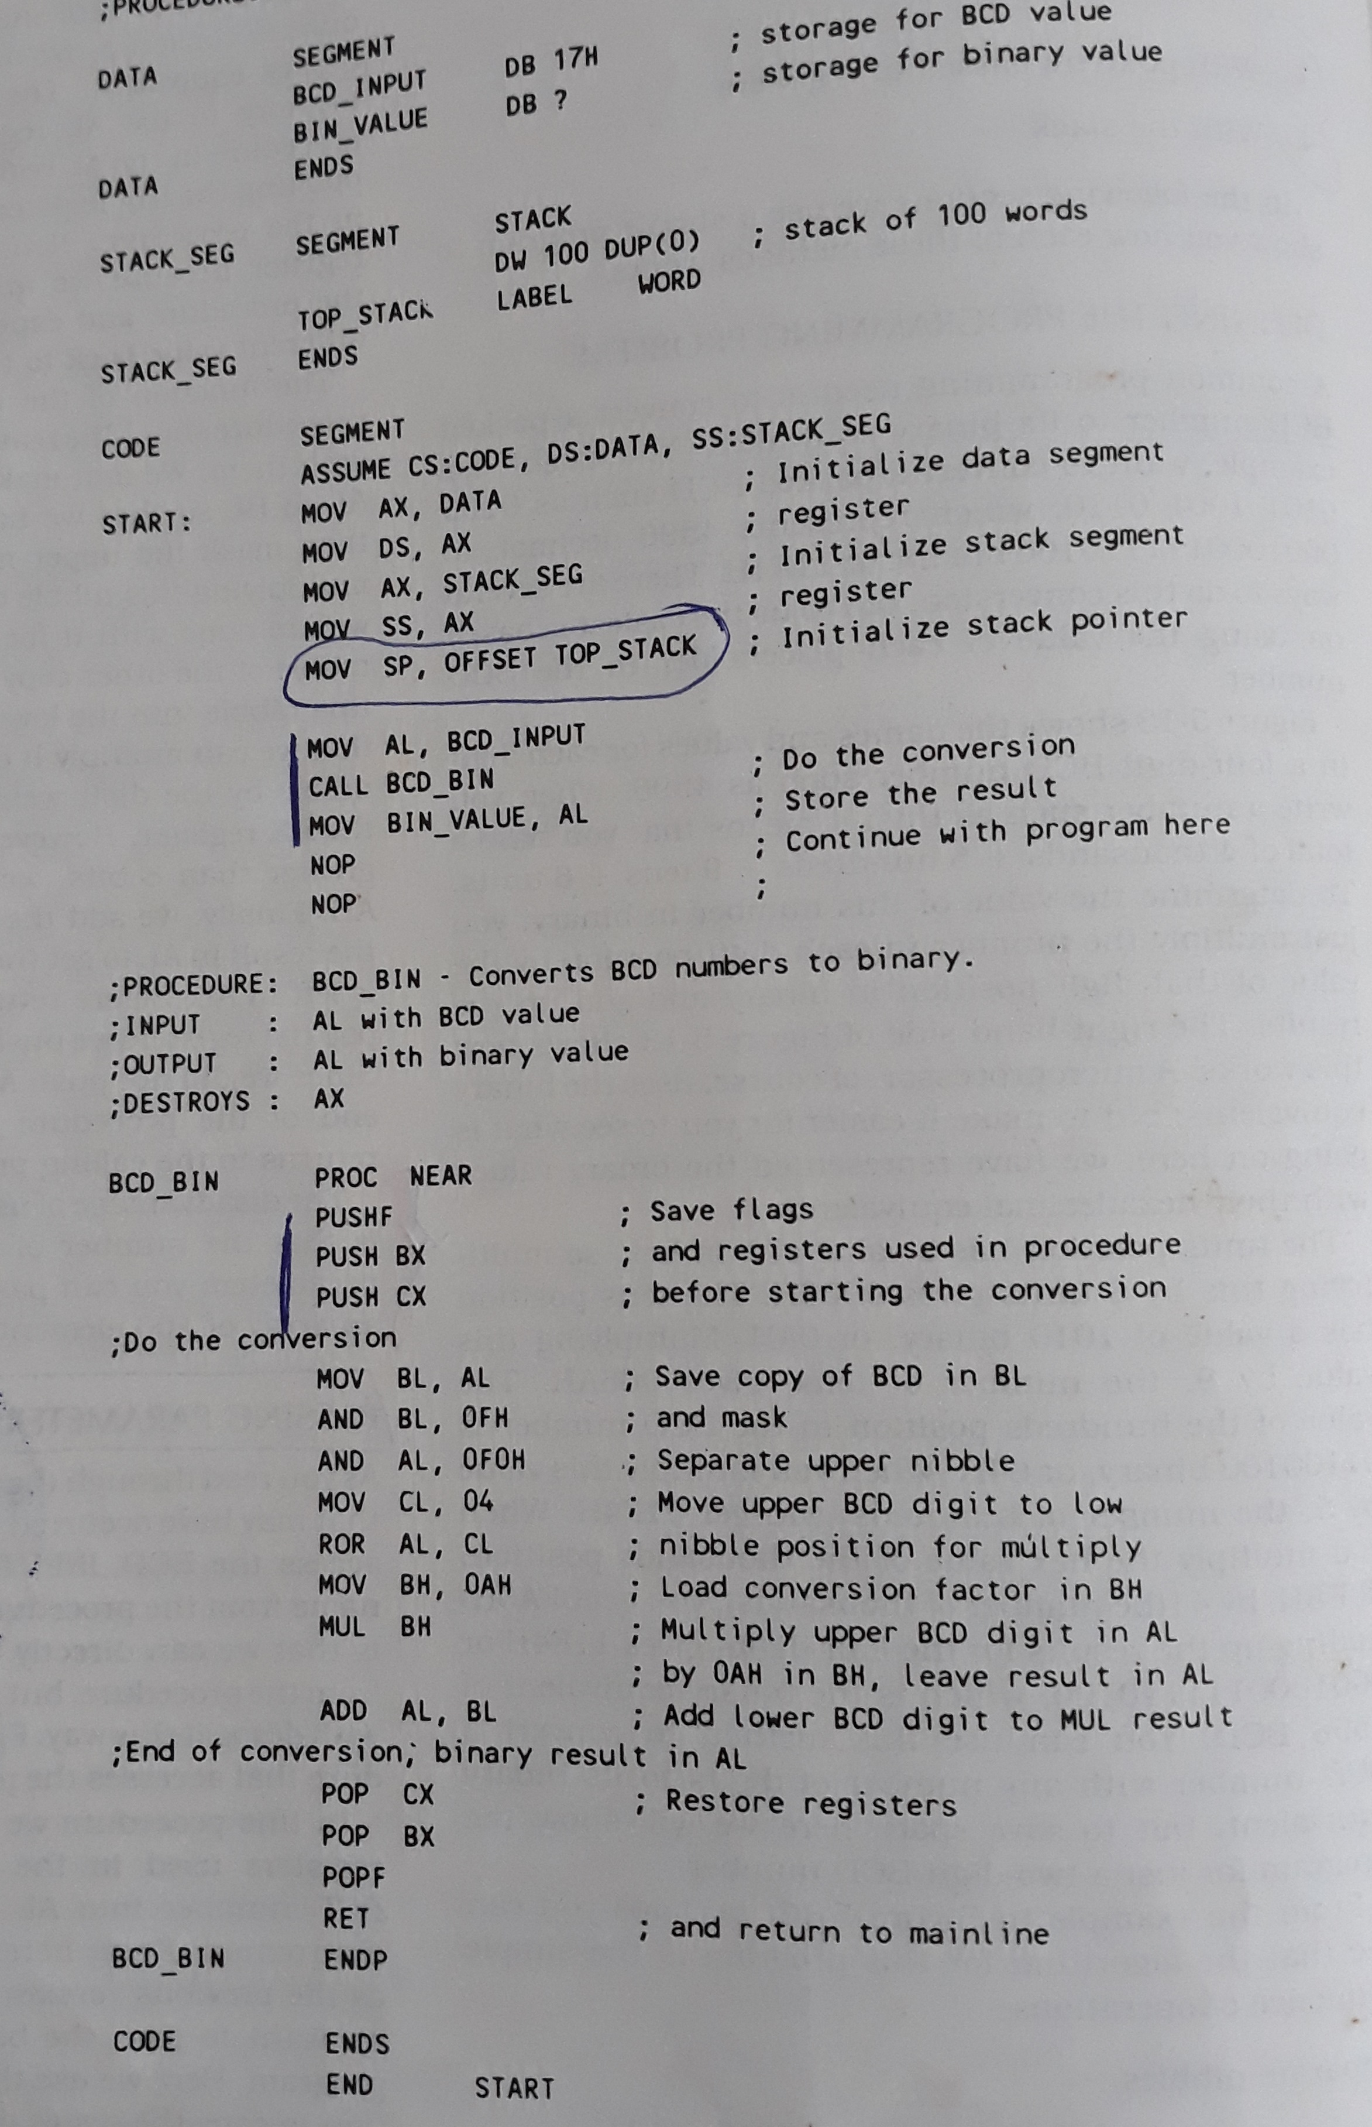
Passing parameters in registers

Slide 4
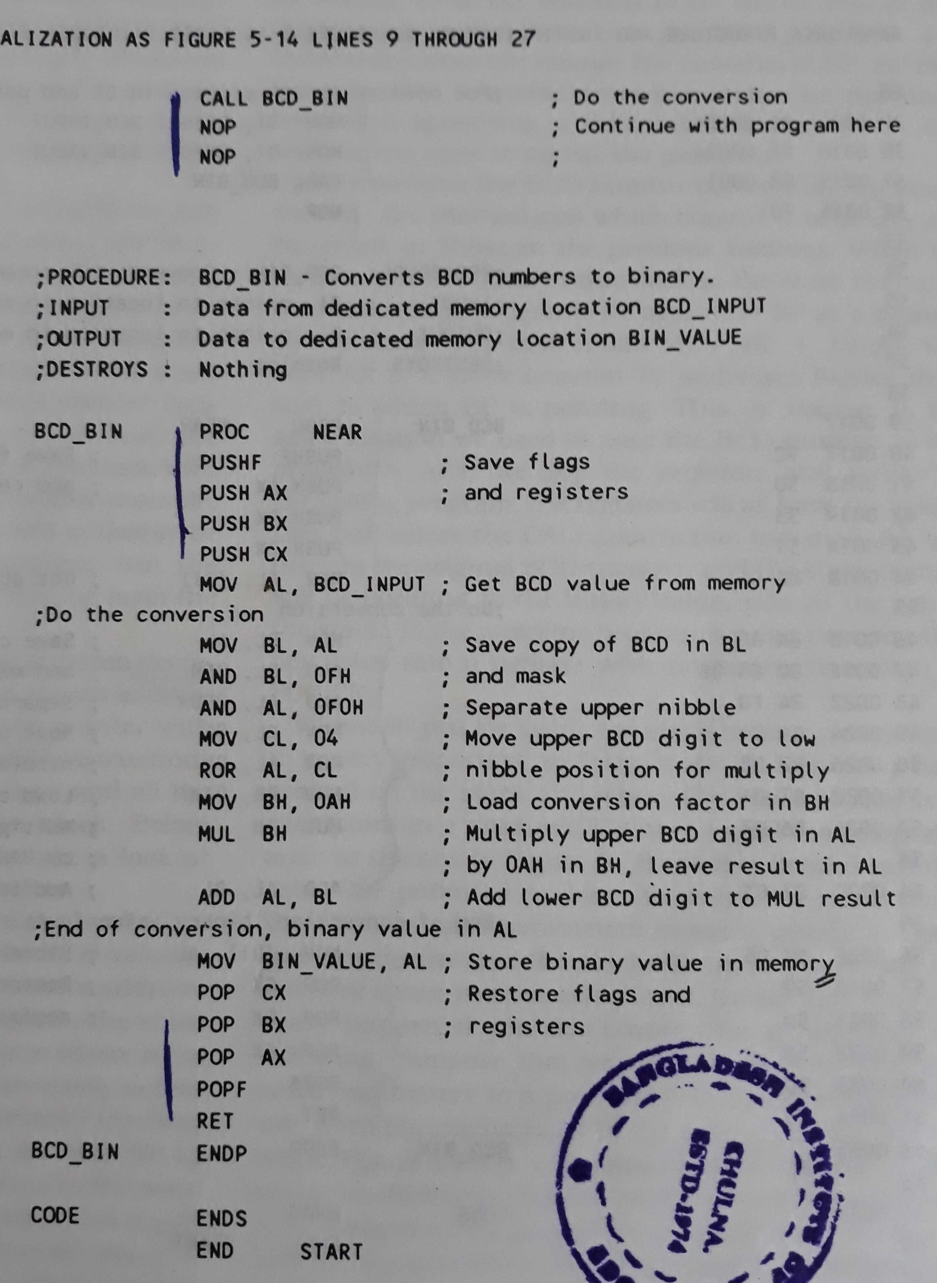
Passing parameters in general memory

Slide 5
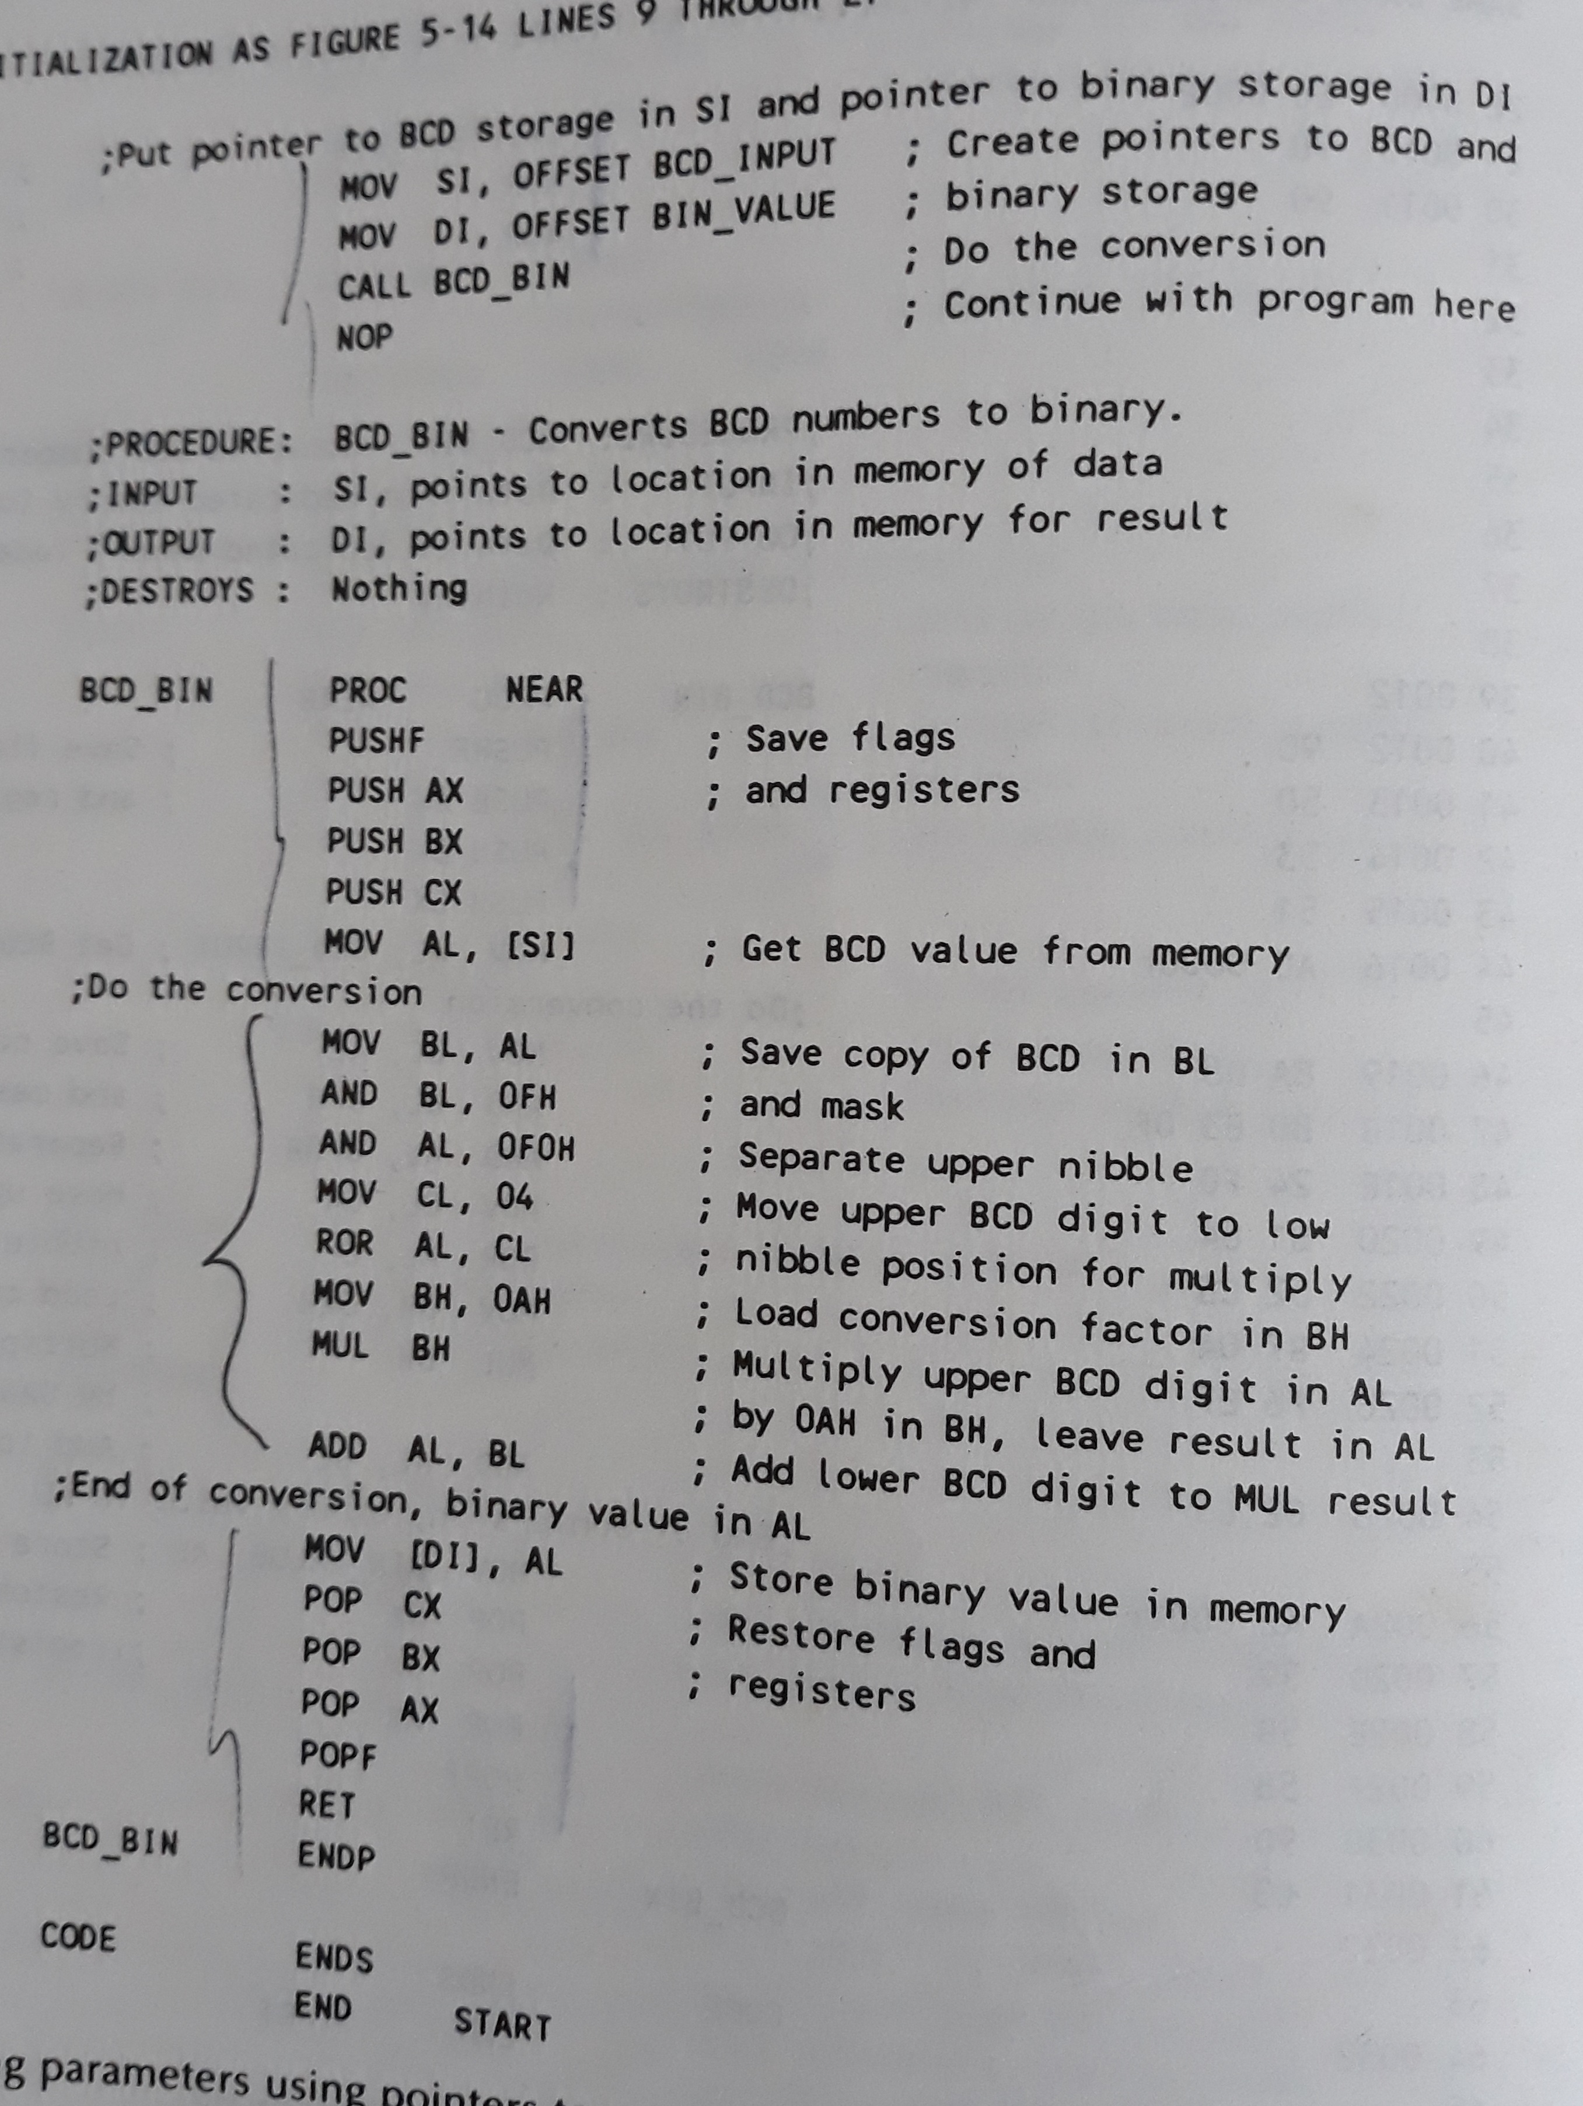
Passing parameters using pointers

Slide 6
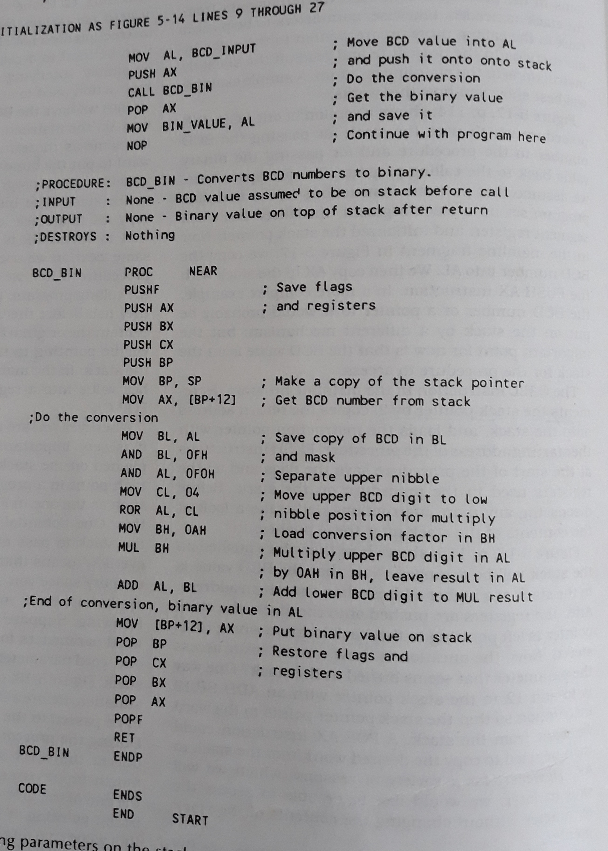
Passing parameters using the stack

Slide 7
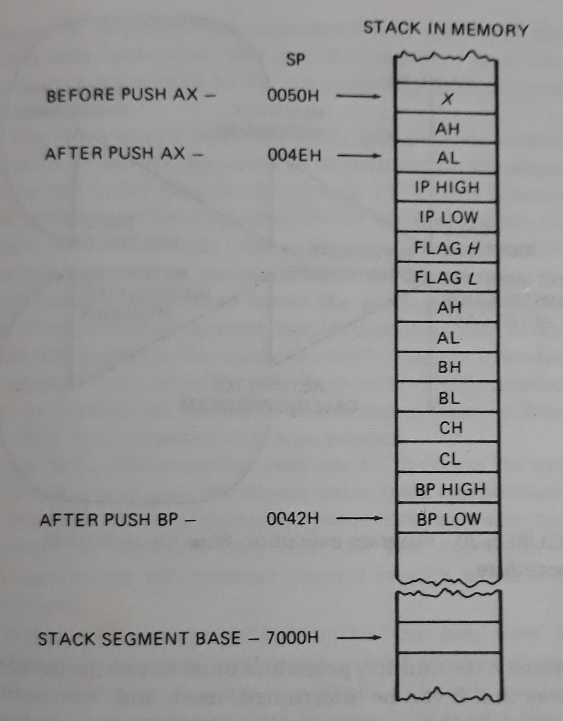

Slide 8
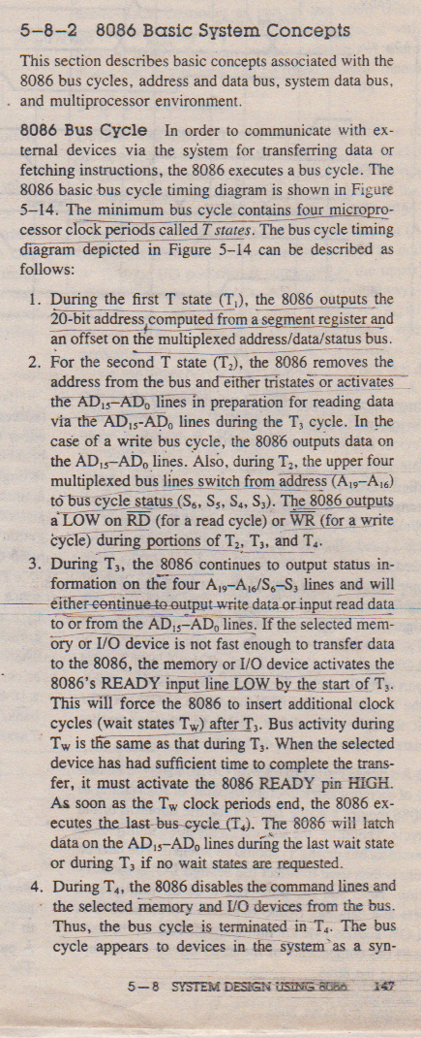
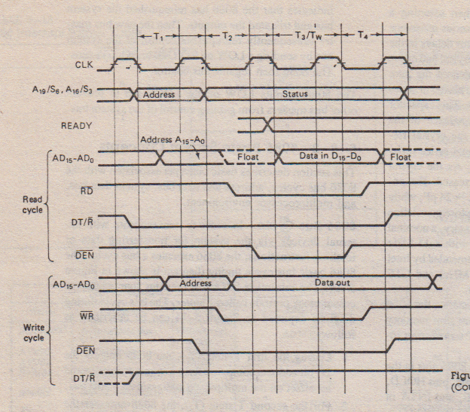
Basic Bus Timing

Slide 9
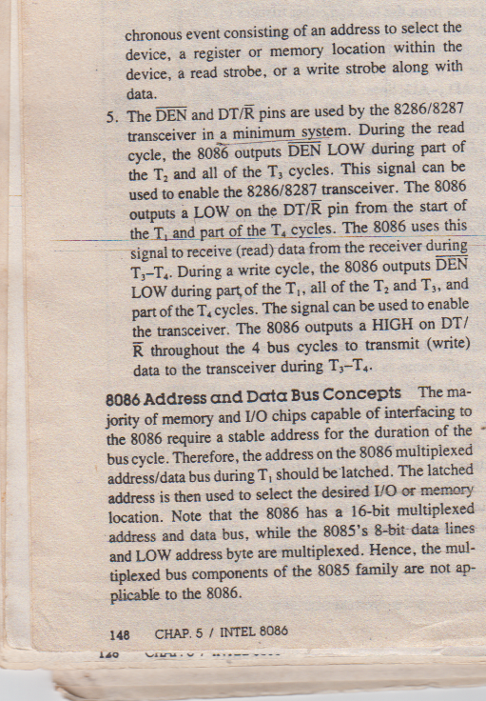
Basic Bus Timing

Slide 10
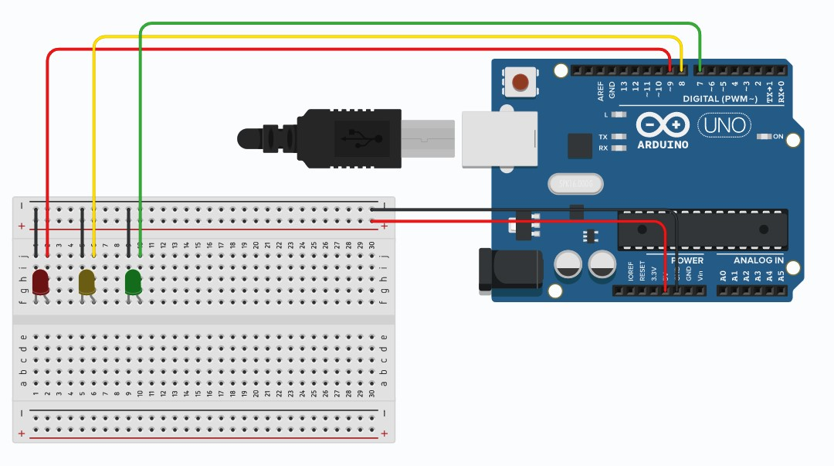

Slide 11
int red = 9;
int yellow = 8;
int green = 7;
void setup(){
pinMode(red, OUTPUT);
pinMode(yellow, OUTPUT);
pinMode(green, OUTPUT);
}
void loop(){
digitalWrite(red, HIGH);
delay(15000);
digitalWrite(red, LOW);
Fig. First Few lines of the code

